Slide 1
CSCI 45: Pipelining Lecture
Professor Kerney

Slide 2
Agenda
Project Demonstrations
Binary Numbers: Shifts and Rotates
Computer Organization: Out of Order Execution
Computer Organization: Register Renaming
Assembly: Homework 3 - Locksmith
Midterm Review

Slide 3
Bit Shifts
To “logically shift” a binary number means to move all the binary digits in that direction (left or right).
Bits that get shifted off the edge vanish
Fill in the new bits with all zeroes.
Each shift left is a x2
Each shift right is a division by 2
To “arithmetically shift” numbers right means that you’re treating the number as a 2’s Complement number, so when you do a right shift it preserves the sign-ness of the number.
Basically you fill it in with 1s (not 0s) if it is negative.

Slide 4
Bit Rotates
To rotate numbers means that bits that fall off the edge of the number get filled back in on the other side.
You can rotate with a carry bit (which gives you an extra bit, essentially), but usually not.
ARM only has rotate rights, but you can just do some algebra and figure out how to convert between a rotate right and a rotate left.

Slide 5
Shifts and Rotates in ARM32
In 16 bit ARM (called Thumb), shifts and rotates are actually commands you can do.
In what we’re programming in (ARM32), they are actually free commands you can do with pretty much any instruction except a multiply.
They get added on to the flexible second operand as a modifier to that operand before anything is done with it.

Slide 6
ASM Examples
MOV r0, r0, LSL #1
Multiply R0 by two.
MOV r1, r1, LSR #2
Divide R1 by four (unsigned).
MOV r2, r2, ASR #2
Divide R2 by four (signed).
MOV r3, r3, ROR #16
Swap the top and bottom halves of R3.
ADD r4, r4, r4, LSL #4
Multiply R4 by 17. (N = N + N * 16)
RSB r5, r5, r5, LSL #5
Multiply R5 by 31. (N = N * 32 – N)
CMP r9, r8, ROR r0
(Rotates r8 right by r0 places) then compares it against r9
Source: http://www.davespace.co.uk/arm/introduction-to-arm/barrel-shifter.html

Slide 7
Out of Order Execution
Once you have a pipeline going in a CPU architecture, the obvious next step is to try to avoid pipeline stalls.
A stall occurs when one command relies on the results of another command. This creates a dependency between the two instructions.
The part of the pipeline responsible for decoding the instruction stream (i.e. reading 1s and 0s and turning it into “ADD R0,R0,R1”) can read quite far ahead (~100 instructions) and figure out which instructions will stall and which can be done without screwing anything up.
So the CPU will execute the commands out of order since it doesn’t matter.
The dependencies can be viewed as a graph...

Slide 8
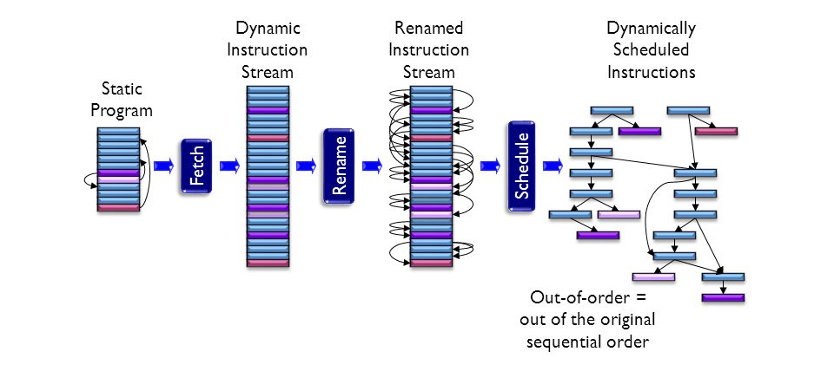
Out of Order Execution
Source: Stony Brook University: http://images.slideplayer.us/7/1776531/slides/slide_8.jpg

Slide 9
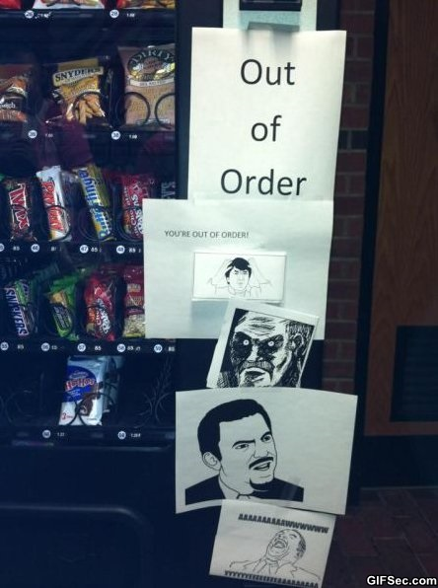
Out of Order

Slide 10
False Dependencies
Dynamic Scheduling allows a CPU to run at top speed by eliminating as many pipeline stalls as possible.
But what if there’s a false dependency?
for (int i = 0; i < 10; i++)
arr[i] = i;
This becomes a series of commands in assembly that are all using (let’s say) R6 which holds the address to write to.
So the CPU will not allow multiple iterations to be run at the same time, despite them not actually having anything to do with them. They could all be done in parallel.

Slide 11
Register Renaming
So the CPU does even more work here and does something called register renaming which will allocate the next go-through of the loop to (let’s say) R7 instead of R6, which will allow both to run in parallel with each other. And maybe the next might use R8.
The reality is actually more complicated – CPU’s often have secret registers that only get accessed in this fashion. So even though you might only (as a programmer) have access to R0 – R15, the CPU itself might have 56 registers available behind the scenes.
“Physical Registers” these are called.

Slide 12
Homework 3 – Locksmith III
Locksmith III is totes unbreakable.
Found in your ~/locksmith3 directory.
The key thing about this one is that it doesn’t give an error message if you fail the copyright check.
Instead, it just makes the game impossible to win.
It will count as extra credit for HW3.

Slide 13
Midterm Review
Part 1 (33%) Binary Stuff
Addition
2’s Complement
Shifts and Rotates
Basically, just review your worksheets
Part 2 (33%) Computer Organization
Answer conceptual questions about the concepts we’ve talked about in class.
Caching, instruction decoding, pipelining, OOE.

Slide 14
Midterm Review
Part 3 (34%) Programming
Connect to the server and write a short assembly program
You will have access to a print function I give you, like in Fizzbuzz
Given a buggy assembly program, fix the bug.
You are expected to know the following:
Arithmetic Operations (add, mul, sub, etc.)
Comparisons (CMP or with the –S suffix)
Branches (BEQ, BGT, BNE, BAL, etc.)
Functions (BL, PUSH and POP, the ABI standard)

